Slide 1
English for
International
Communication

Slide 2
奠基篇 Unit 1
聽力必備技能

Slide 3
奠基篇 Unit 1
聽力應考對策
多益測驗為要評量出應試者在國際職場環境中使用英語的能力，聽力部分的錄音採母語人士「真實速度」的口語英語，這讓許多考生常覺得跟不上或抓不到完整意思。而新制多益測驗加上美、加、英、澳四國口音以符合職場的真實狀況，更讓許多考生感到不安。本單元將針對聽力測驗提供必備技能，以奠定應考基礎。

Slide 4
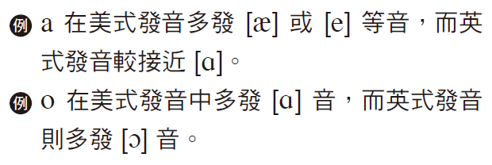
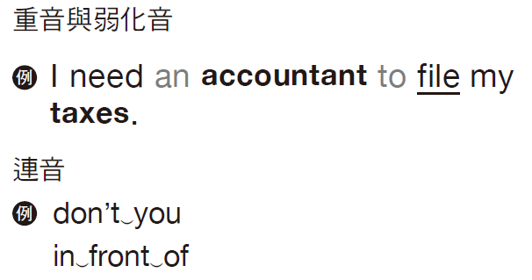
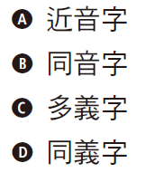
奠基篇 Unit 1
必備技能
技能1 | 聽懂四國發音
技能2 | 克服聽力障礙
技能3 | 熟悉發音陷阱

Slide 5
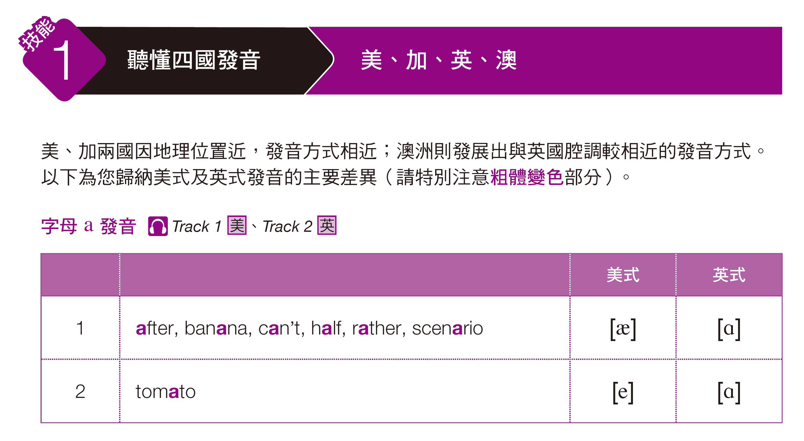

奠基篇 Unit 1

Slide 6
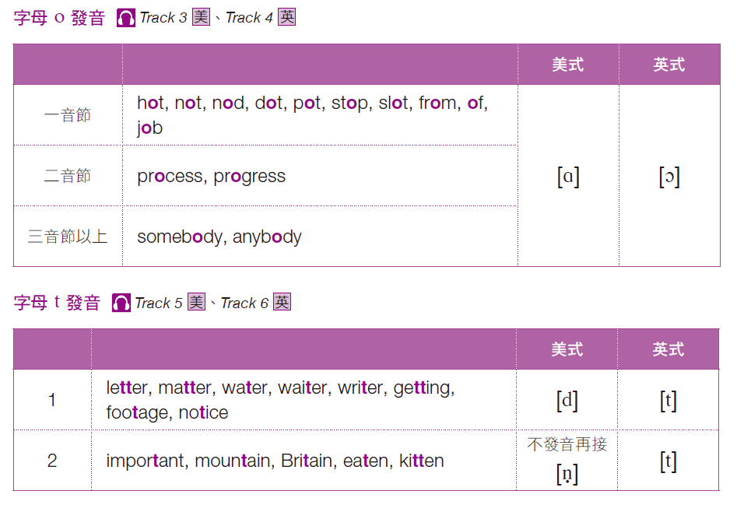
奠基篇 Unit 1

Slide 7
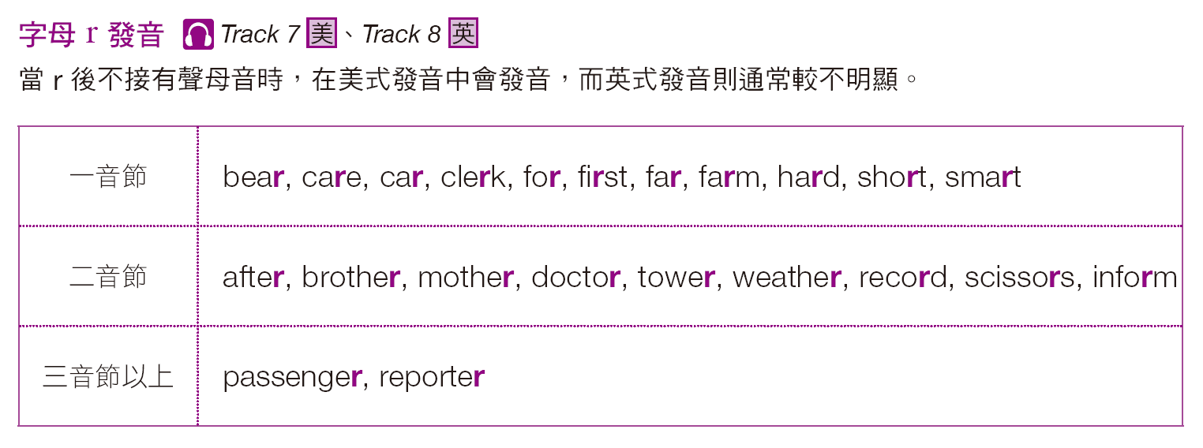
奠基篇 Unit 1
美式： 英式：

Slide 8
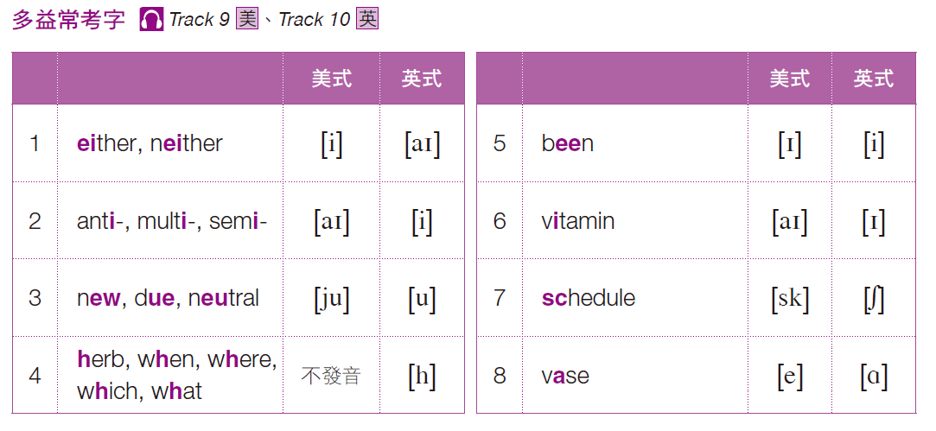
奠基篇 Unit 1
美式： 英式：

Slide 9
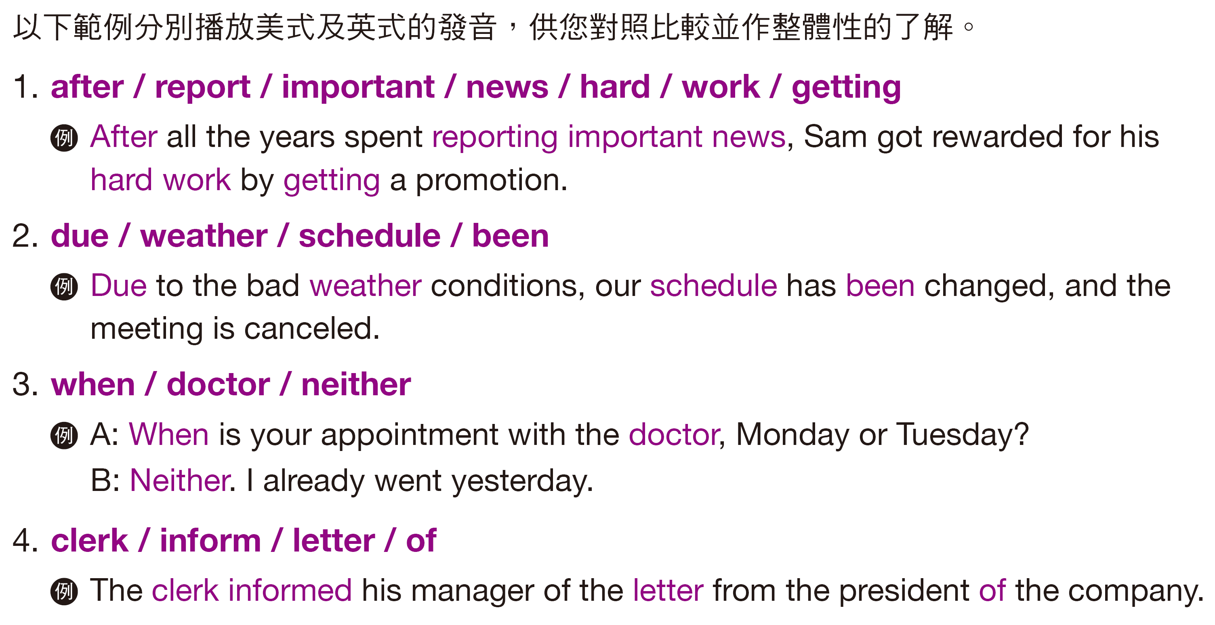
奠基篇 Unit 1
Examples
美式： 英式：

Slide 10
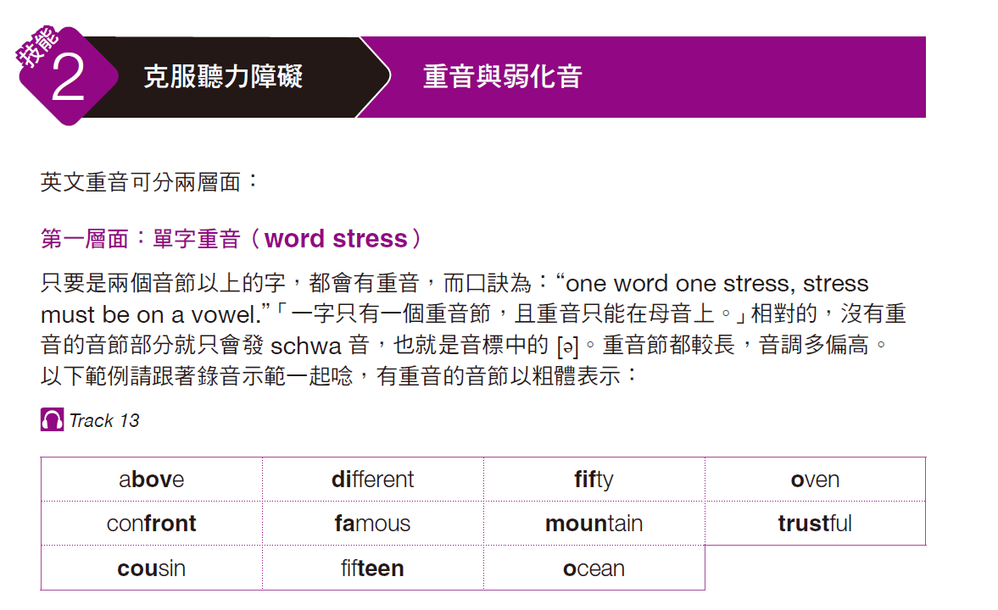
奠基篇 Unit 1

Slide 11
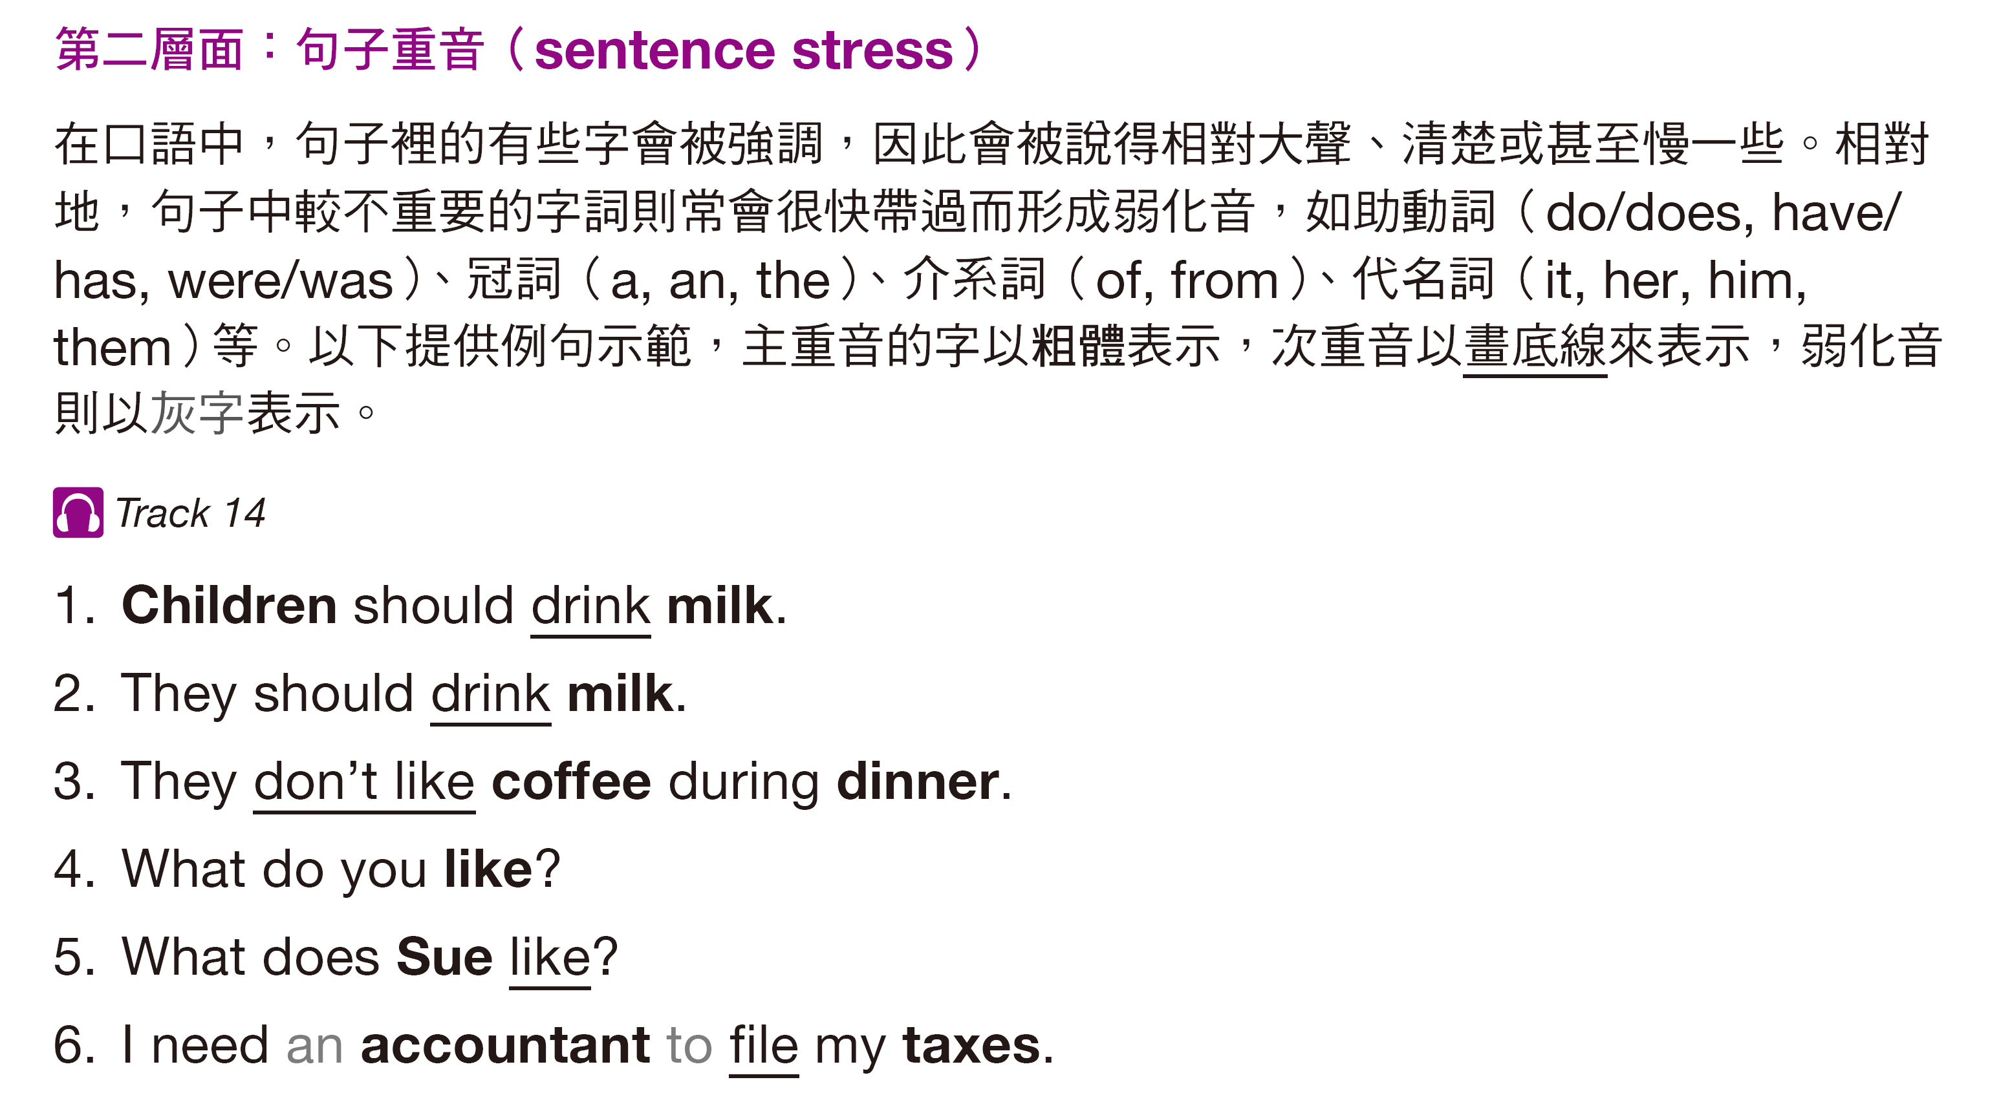
奠基篇 Unit 1

Slide 12
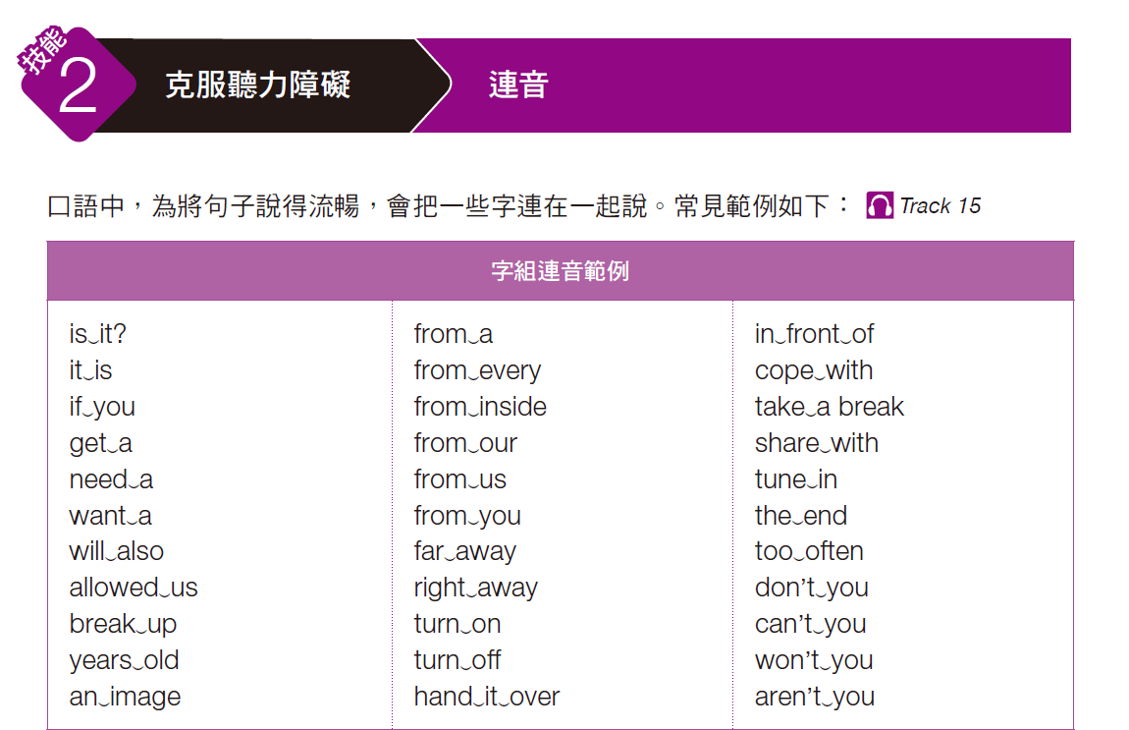
奠基篇 Unit 1

Slide 13
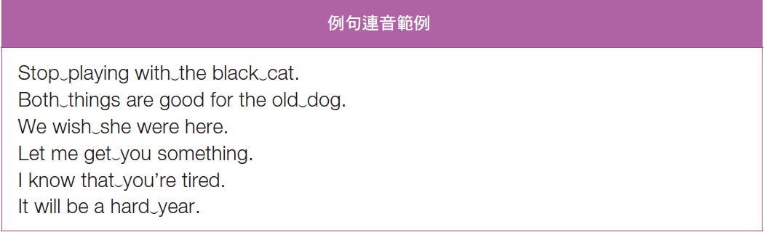
奠基篇 Unit 1

Slide 14
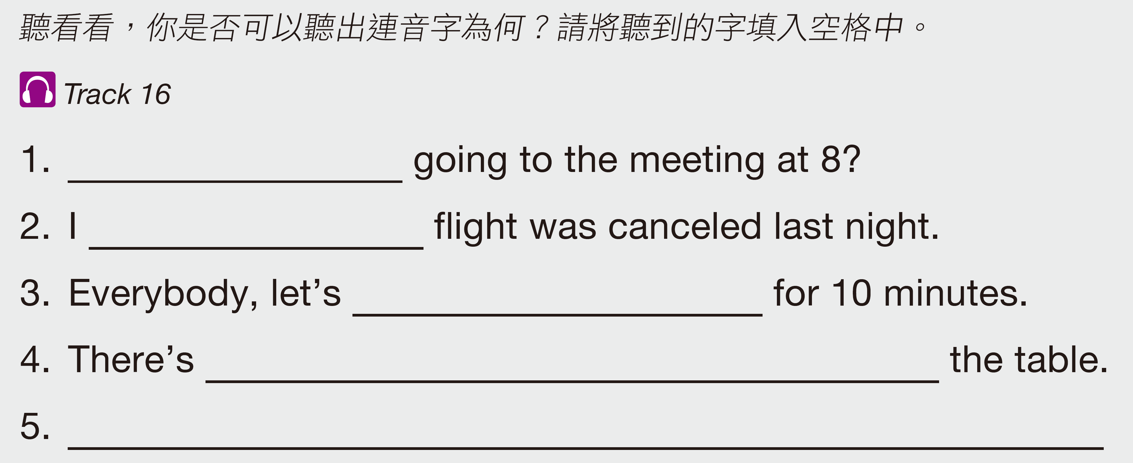
奠基篇 Unit 1
Exercise
Are we
heard your
take a break
an umbrella in front of
This is a hot Tuesday.

Slide 15
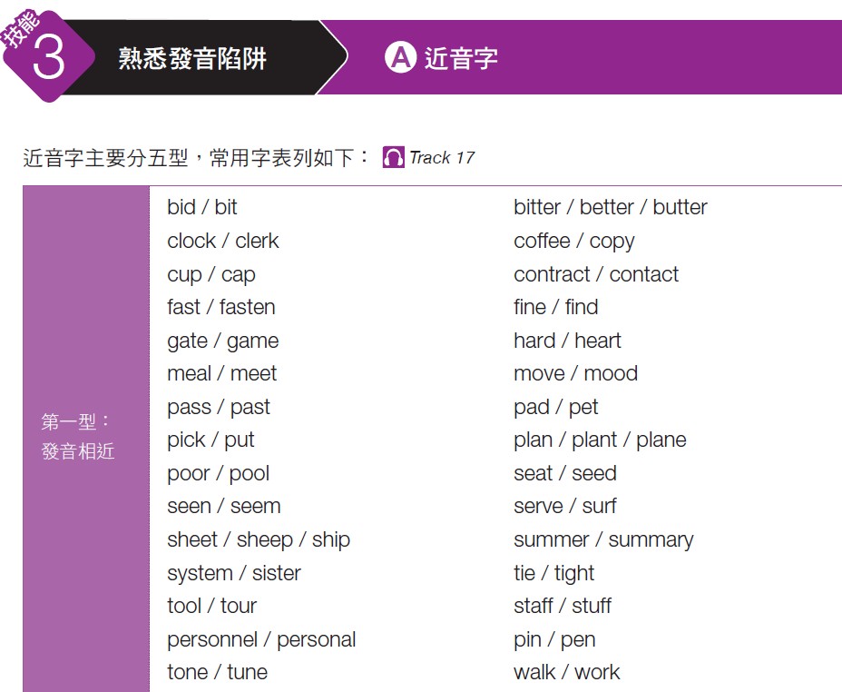
奠基篇 Unit 1

Slide 16
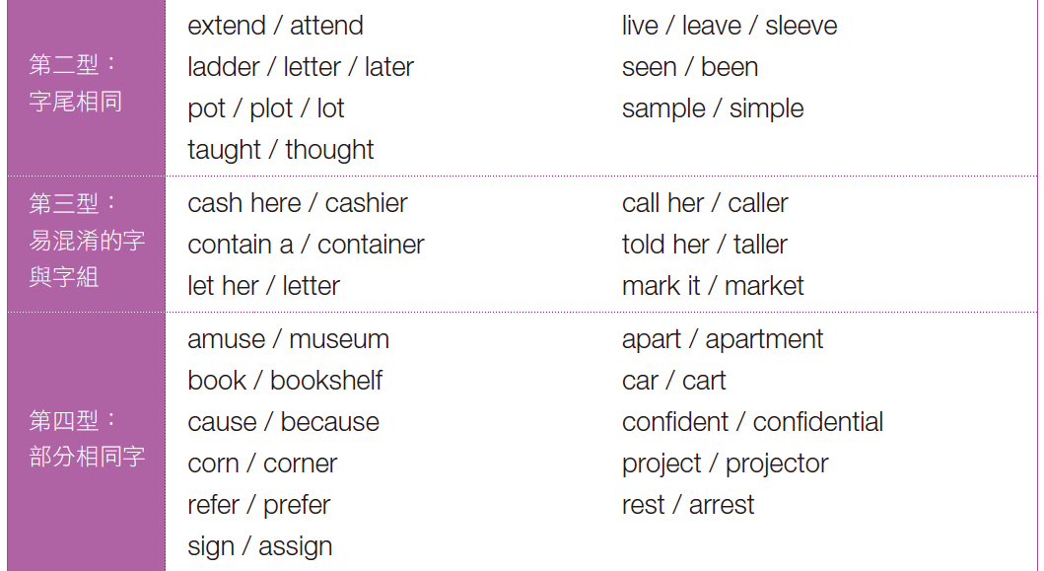
奠基篇 Unit 1

Slide 17
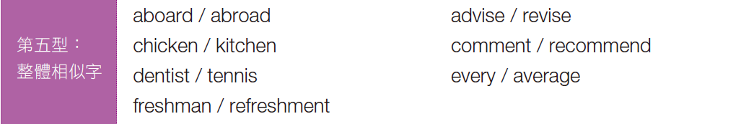
奠基篇 Unit 1

Slide 18
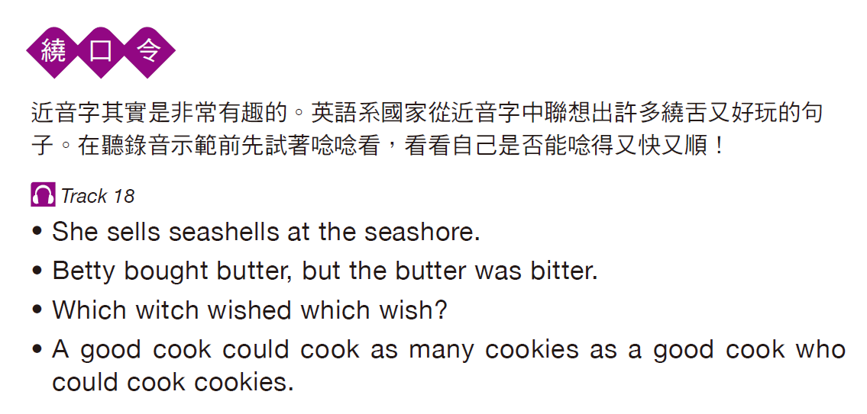
奠基篇 Unit 1

Slide 19
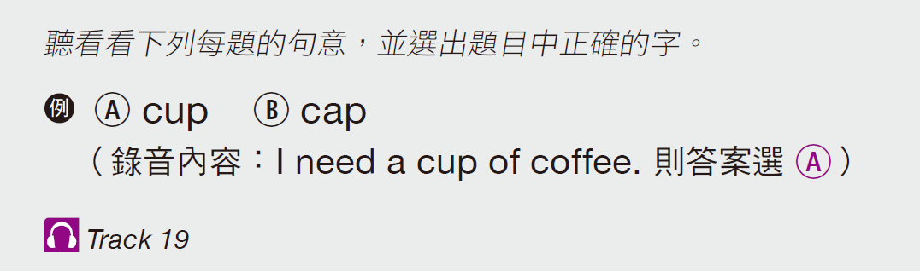
奠基篇 Unit 1
Exercise
Your answer | A | B
1. Ⓐ Ⓑ 2. Ⓐ Ⓑ 3. Ⓐ Ⓑ 4. Ⓐ Ⓑ 5. Ⓐ Ⓑ
A
A
B
A
B
cart
better
putting
sister
market
car
butter
picking
system
mark it

Slide 20
奠基篇 Unit 1
Audio Transcripts
1. The woman is pushing the shopping cart down the aisle.
2. Our sales will get better with the new strategy.
3. He is picking an apple from the shelf.
4. Please tell your sister to be on time tomorrow.
5. Please mark it down before I forget.

Slide 21
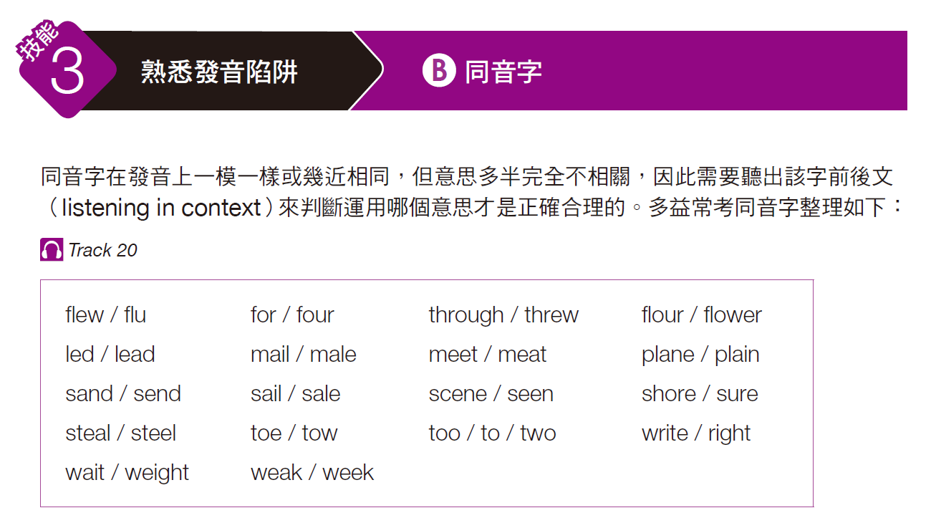
奠基篇 Unit 1

Slide 22
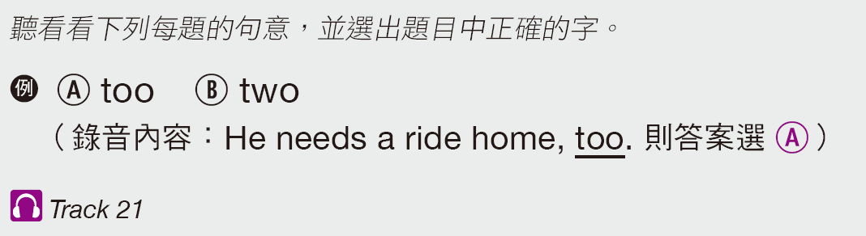
奠基篇 Unit 1
Exercise
Your answer | A | B
1. Ⓐ Ⓑ 2. Ⓐ Ⓑ 3. Ⓐ Ⓑ 4. Ⓐ Ⓑ 5. Ⓐ Ⓑ
B
A
A
B
B
male
week
four
sure
to
mail
weak
for
shore
two

Slide 23
奠基篇 Unit 1
Audio Transcripts
1. Susan sent the mail through standard delivery yesterday.
2. Last week was certainly a tough one for the team.
3. His birthday is coming in four days.
4. They are taking a walk along the shore.
5. He bought two tickets for the show.

Slide 24
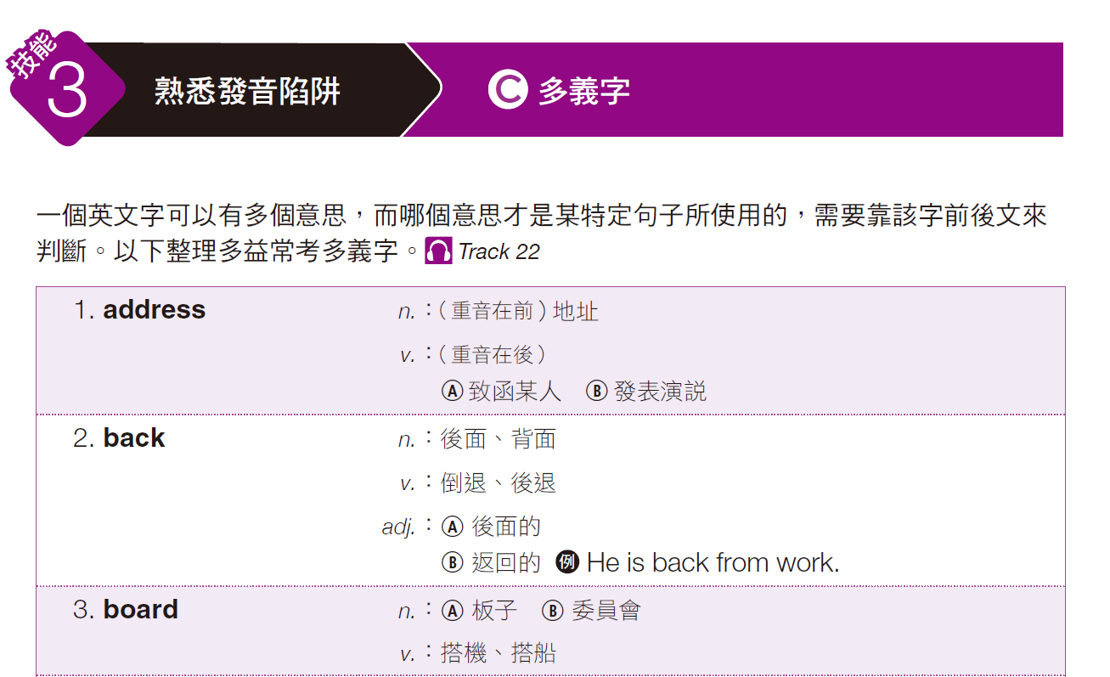
奠基篇 Unit 1

Slide 25
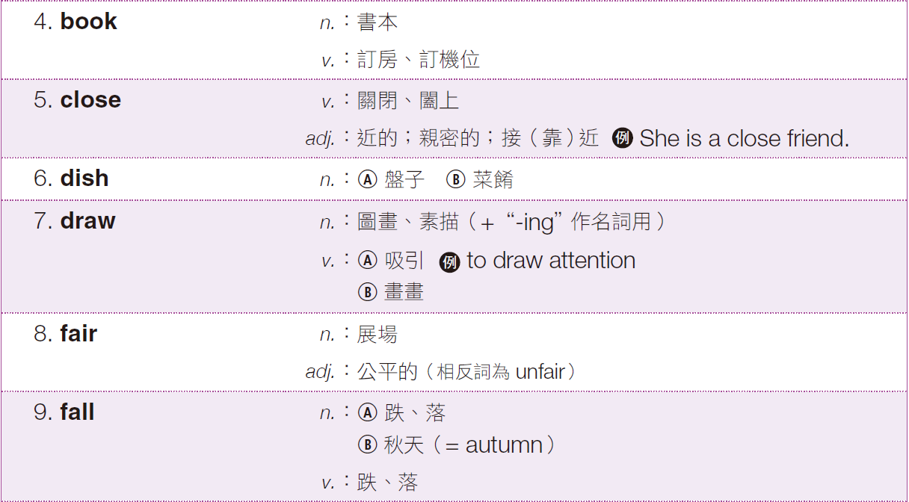
奠基篇 Unit 1

Slide 26
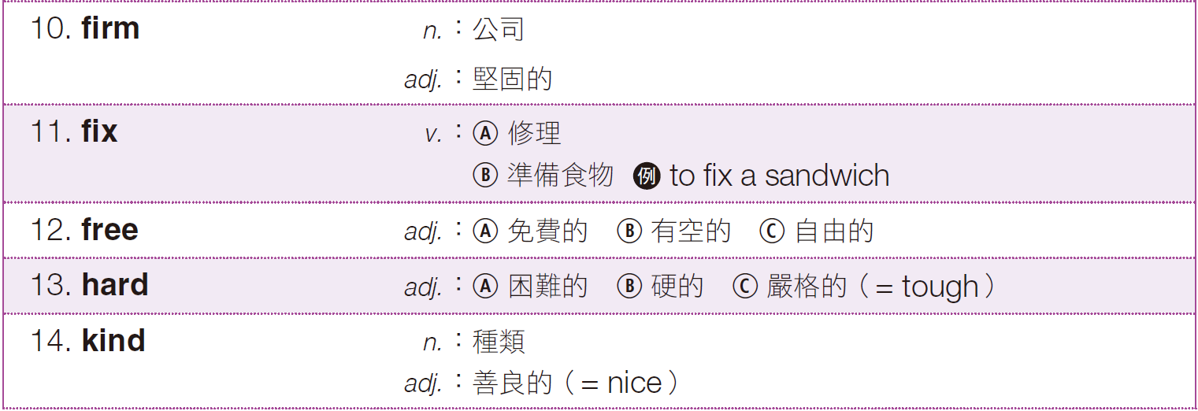
奠基篇 Unit 1

Slide 27
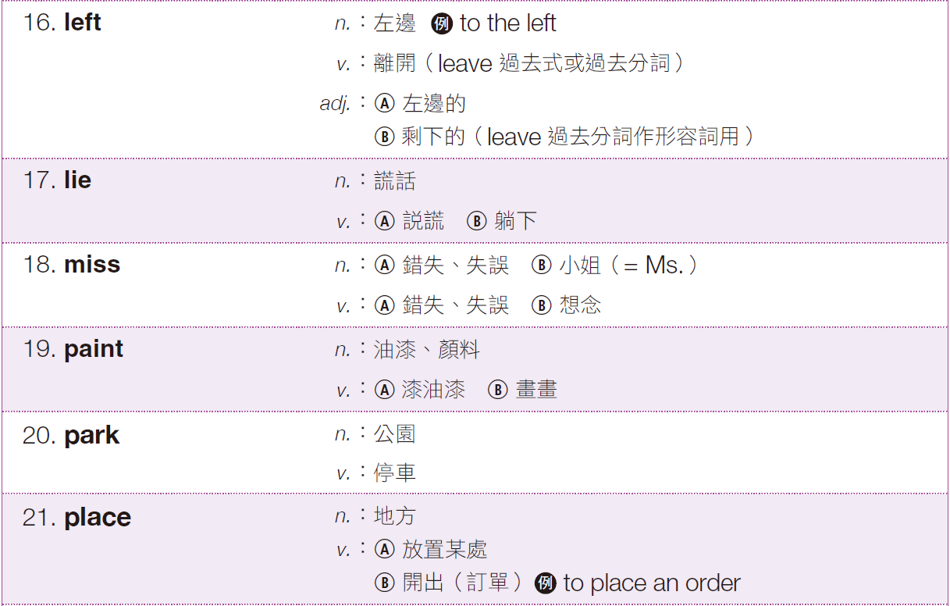
奠基篇 Unit 1

Slide 28
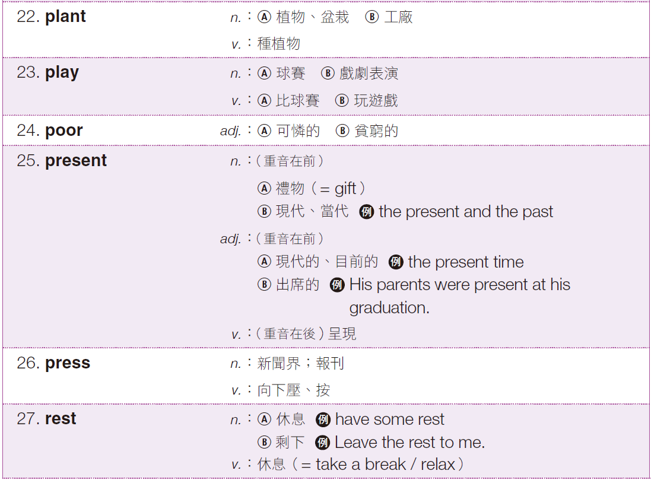
奠基篇 Unit 1

Slide 29
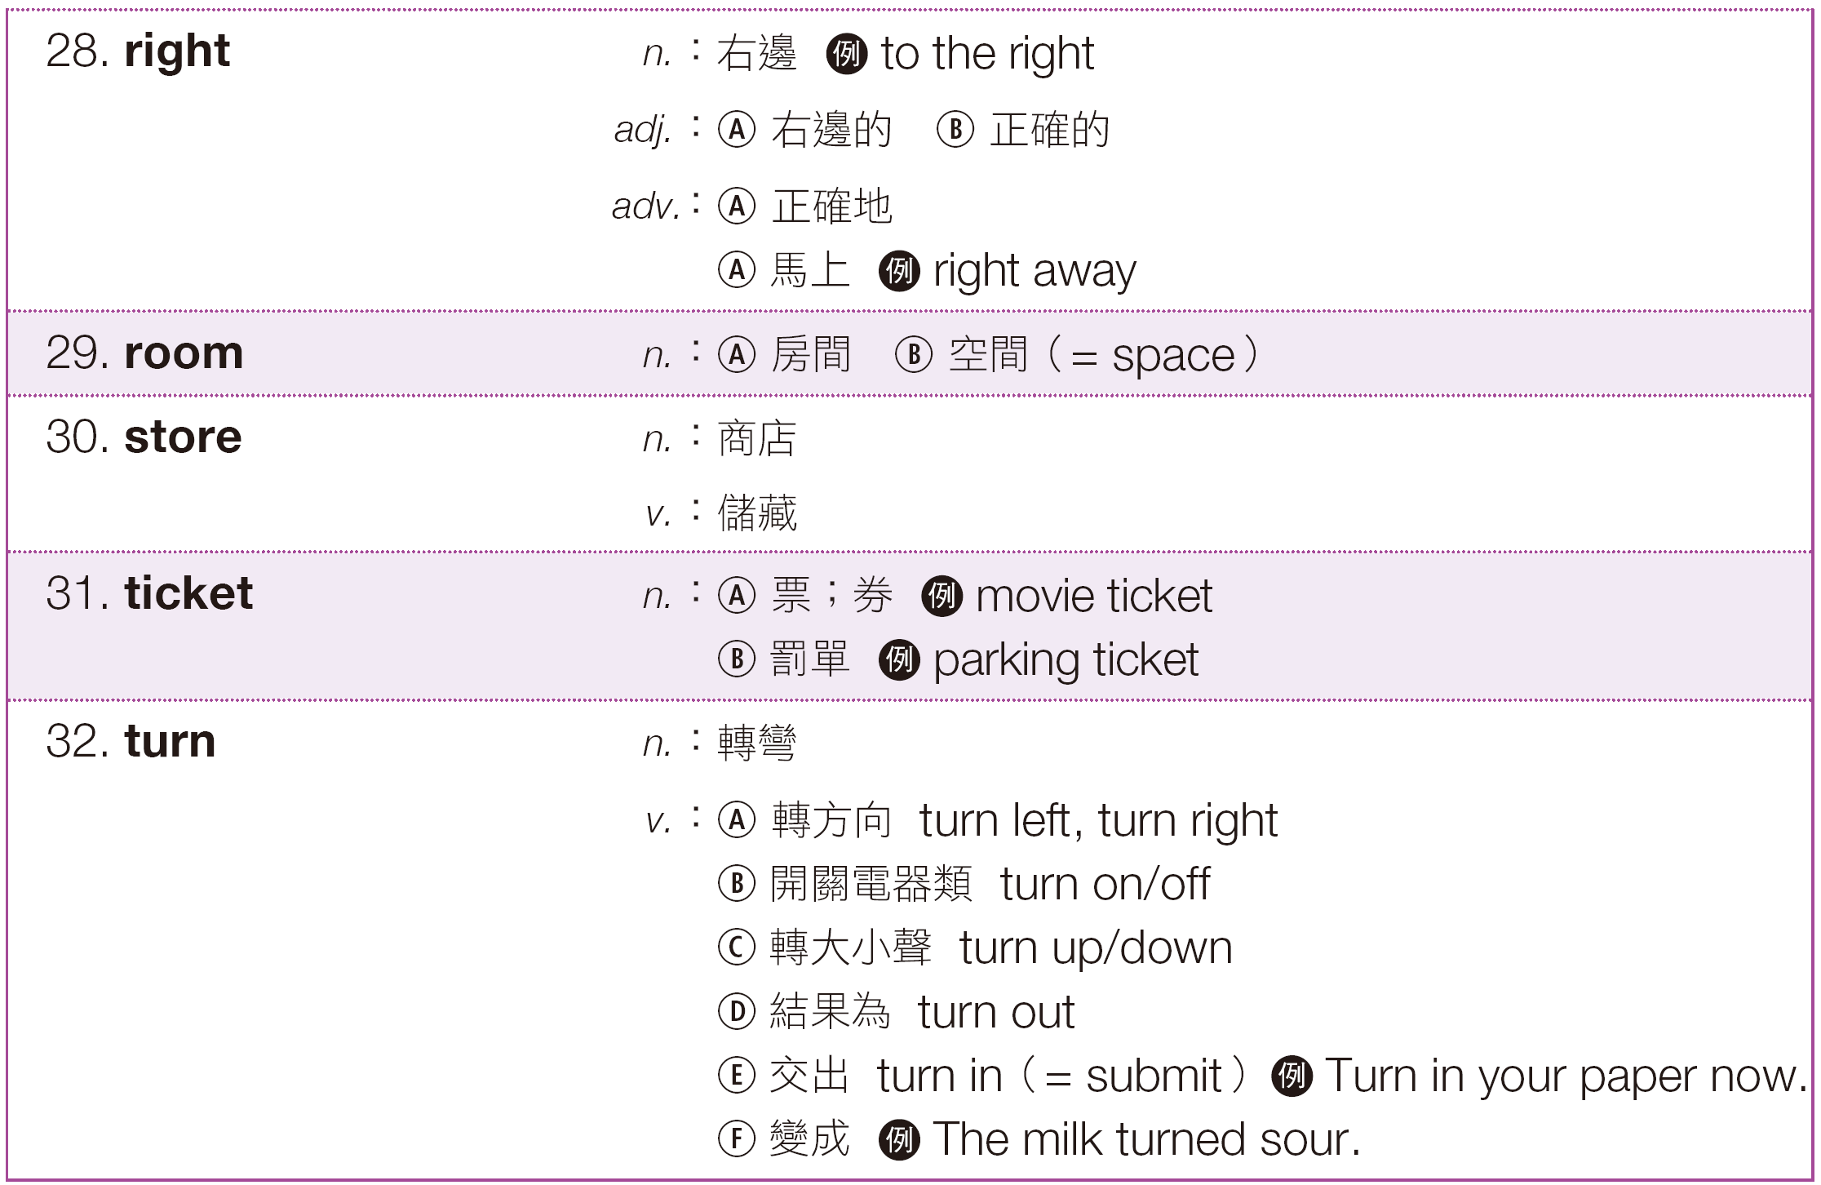
奠基篇 Unit 1

Slide 30
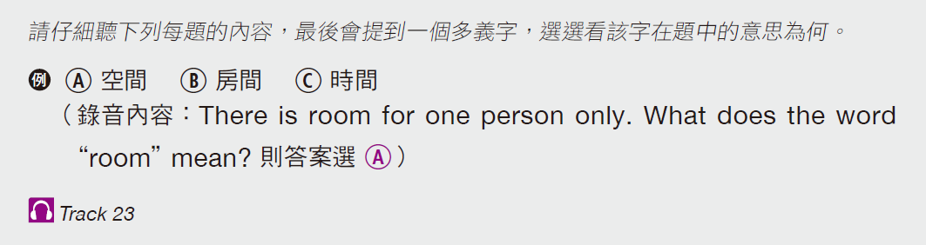
奠基篇 Unit 1
Exercise
Your answer | A | B | C
1. Ⓐ Ⓑ Ⓒ 2. Ⓐ Ⓑ Ⓒ 3. Ⓐ Ⓑ Ⓒ 4. Ⓐ Ⓑ Ⓒ 5. Ⓐ Ⓑ Ⓒ
A
B
A
B
C
可憐的
票
正確地
新聞界
商店
游泳池
罰單
馬上
按
故事
貧窮的
籃子
右邊
衣服
儲藏

Slide 31
奠基篇 Unit 1
Audio Transcripts
1. Poor John! He had a bad day today. What does the word “poor” mean?
2. The police gave him a ticket for speeding. What does the word “ticket” mean?
3. If I remember right, the post office is on the left side. What does the word “right” mean?
4. If you want to talk to our representatives, press 1. What does the word “press” mean?
5. We can store our goods in the garage. What does the word “store” mean?

Slide 32
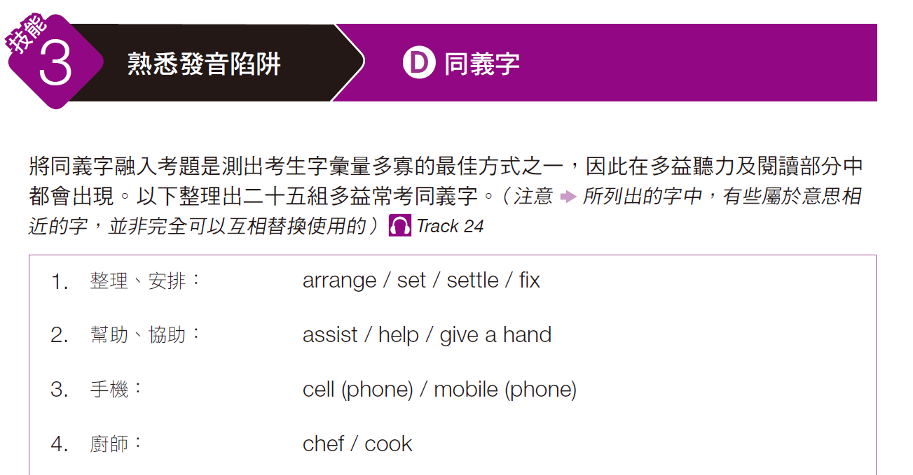
奠基篇 Unit 1

Slide 33
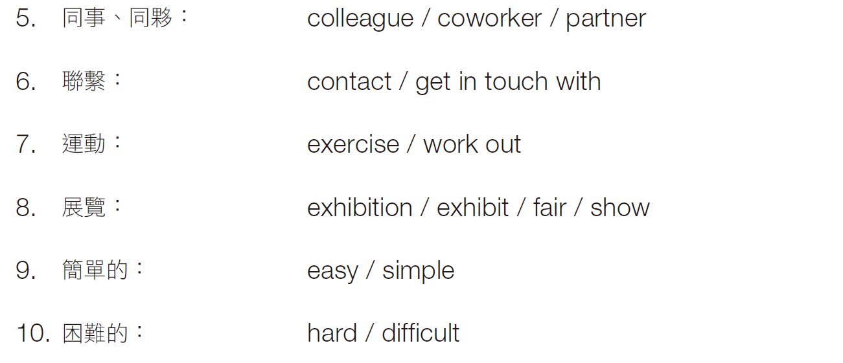
奠基篇 Unit 1

Slide 34
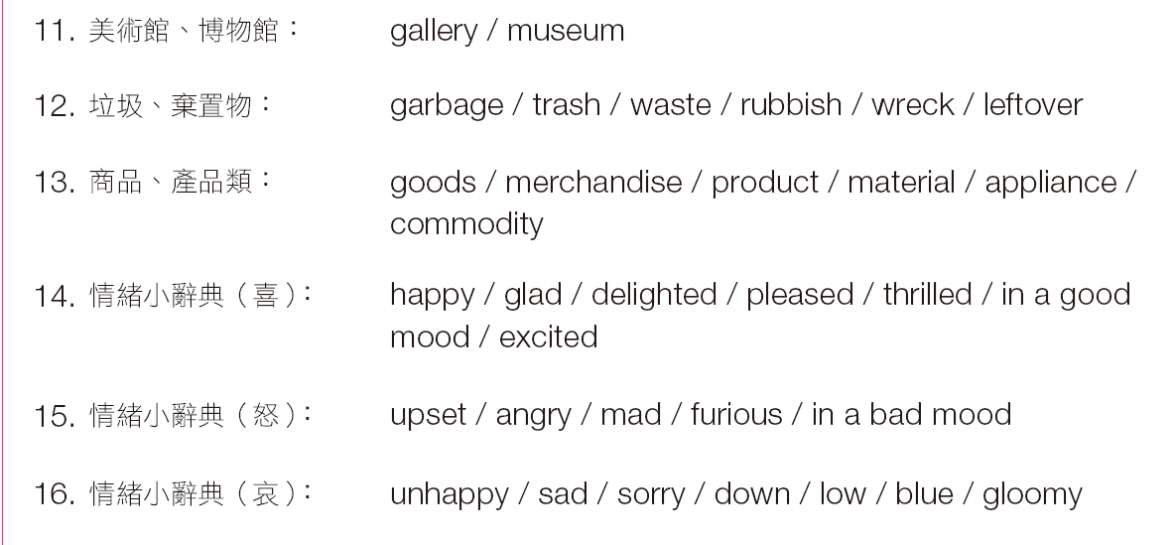
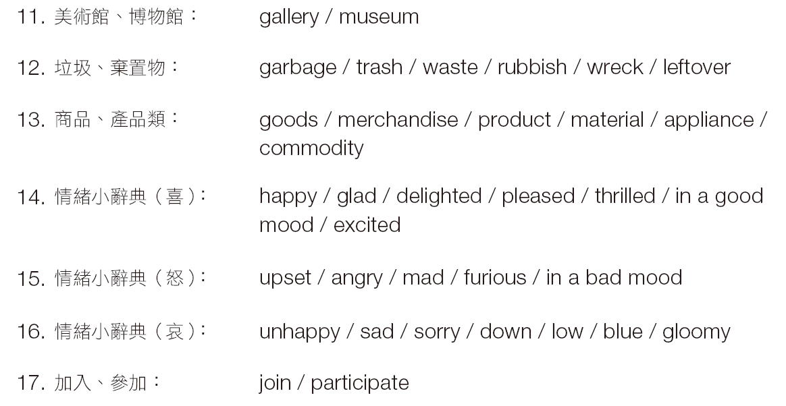
奠基篇 Unit 1

Slide 35
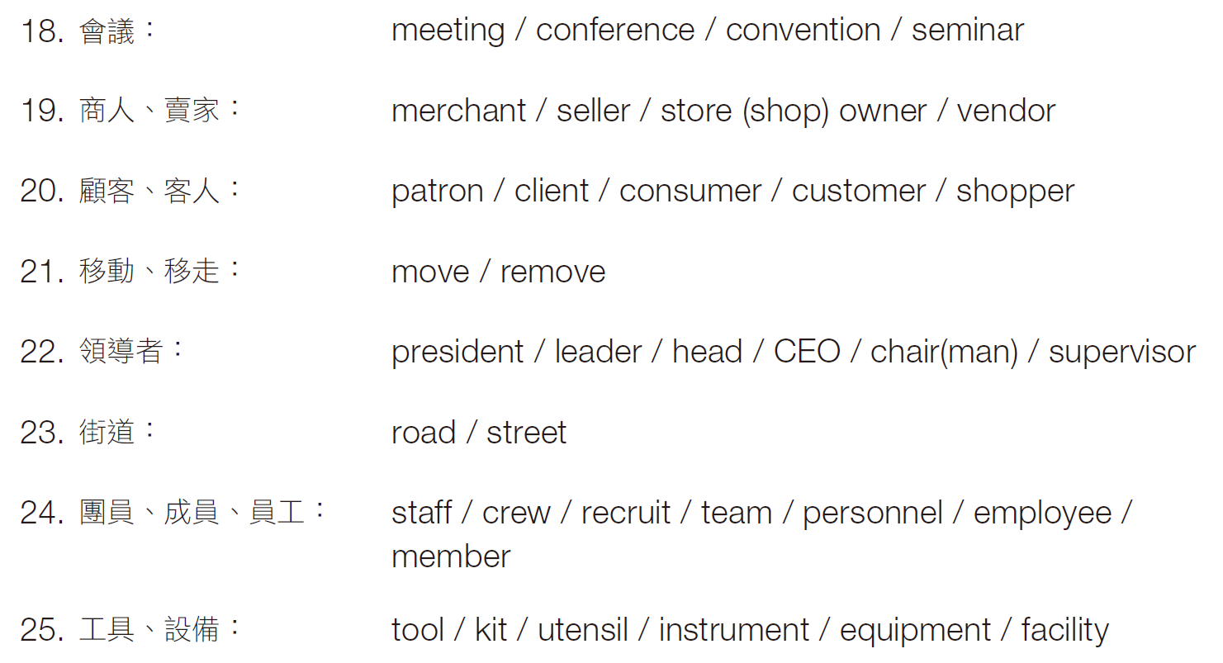
奠基篇 Unit 1

Slide 36
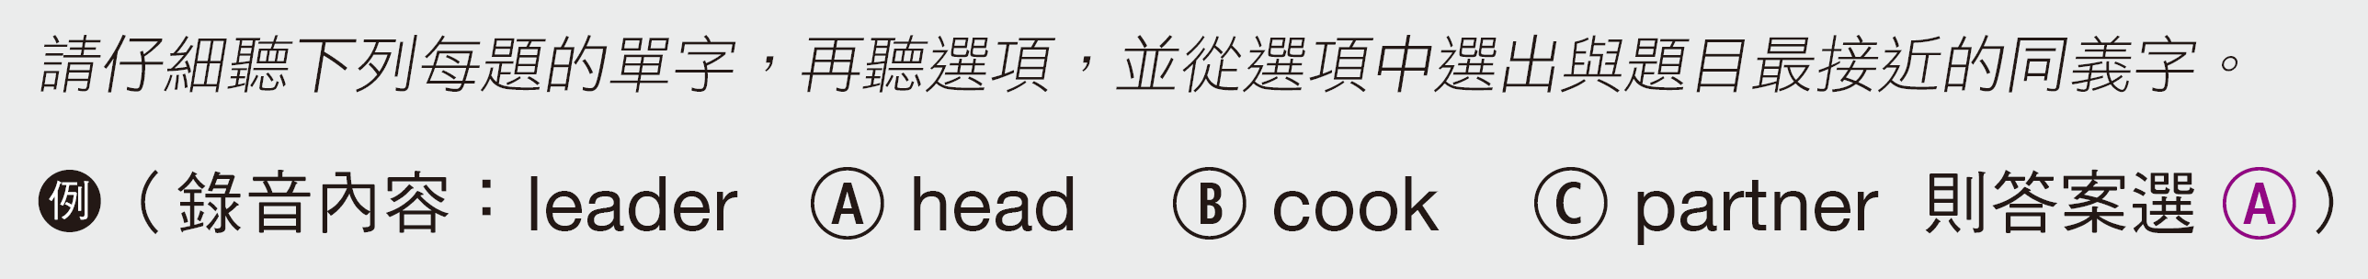
奠基篇 Unit 1
Exercise
B
_____ 1.
_____ 2.
_____ 3.
_____ 4.
_____ 5.
happy A low B delighted C blue
C
easy A crazy B east C simple
A
hard A difficult B raw C soft
A
merchant A seller B consumer C officer
B
chef A waiter B cook C bookshelf

Slide 37
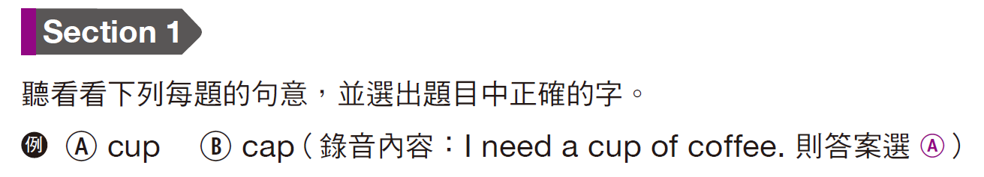
奠基篇 Unit 1
Practice Test
 | A | B
1. 2. 3. 4. 5.
 | A | B
1. 2. 3. 4. 5.
B
A
B
A
A
tennis
ladder
aboard
average
contract
dentist
letter
abroad
every
contact
A
A
B
B
A
tow
wait
threw
write
plane
toe
weight
through
right
plain

Slide 38
奠基篇 Unit 1
Audio Transcripts
1. The dentist is checking the child.
2. He is propping the ladder against the wall.
3. Sarah likes to travel abroad every year.
4. Next week’s average temperature is 10 degrees.
5. They signed a contract during the meeting.
6. The police will tow your car away if you park here.
7. I am freezing. How much longer do we have to wait?
8. The service will be provided from Monday through Friday.
9. You should get ready for the conference right now.
10. The plane flies from New York to Miami.

Slide 39
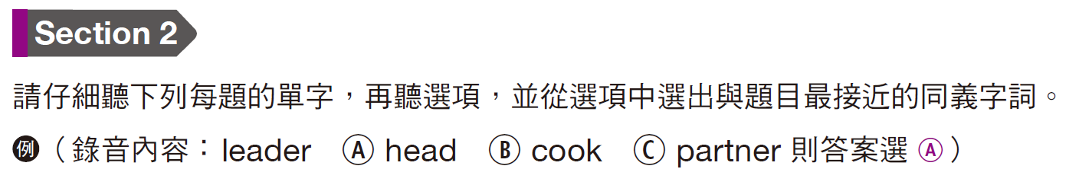
奠基篇 Unit 1
A
_____ 11.
_____ 12.
_____ 13.
_____ 14.
_____ 15.
arrange A set B appoint C furniture
sad A excited B furious C blue
meeting A move B conference C date
assist A fix B give a hand C settle
exhibit A vendor B fair C gloomy
C
B
B
B

Slide 40
奠基篇 Unit 1
A
_____ 16.
_____ 17.
_____ 18.
_____ 19.
_____ 20.
trash A waste B flour C mail
president A gift B sister C head
staff A personnel B rubbish C weight
tool A letter B weather C instrument
exercise A work out B set C copy
C
A
C
A

Slide 41
奠基篇 Unit 1
聽力必備技能
-The End-

